Slide 1
Simple Evidence That Destroys The Despair Of The Climate Change Narrative
Ian McIntosh
(B.App.Sci.Rur.Tech.(Hons))
6 March 2025
Email address – iansteph67@outlook.com

Slide 2
Why Is This Topic So Important?

Slide 3
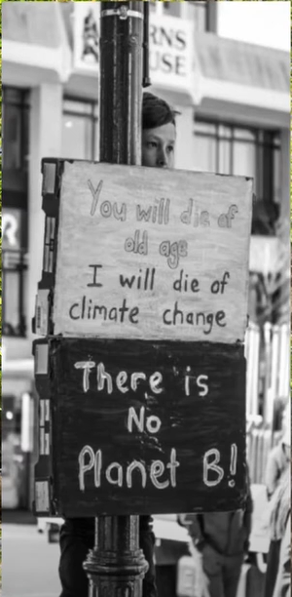
The thinking of many is desperate.
This young lady says
“You will die of old age
I will die of climate change
There is No Planet B!”

Slide 4
A NZ primary school child was crying as he came home from school. His mother asked him what was wrong.
His teacher had told him that he had to hate his Dad for being a dairy farmer.

Slide 5
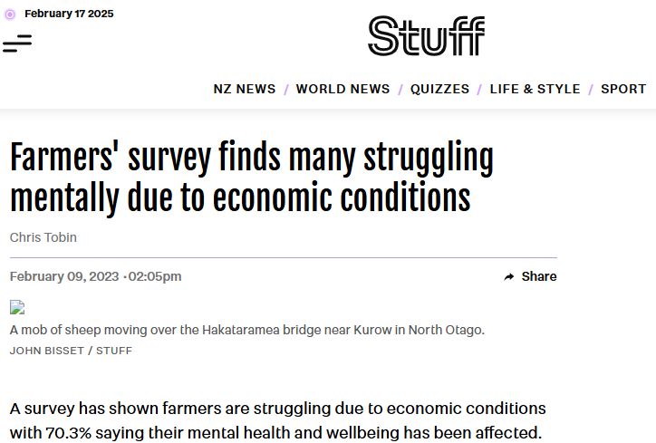


Slide 6
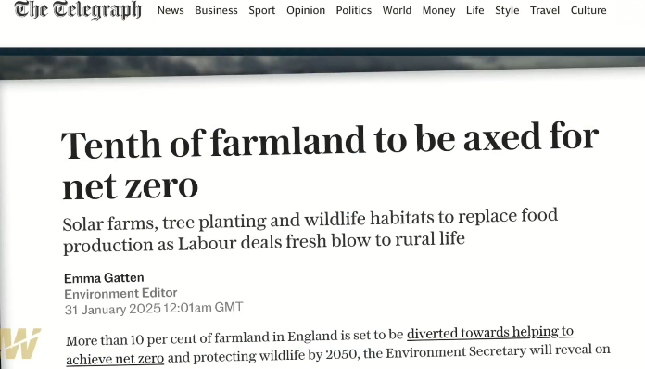
In The UK
https://thehighwire.com/ark-videos/aiding-and-abetting/?pg=2

Slide 7
The Despair Is Because We Are Told That Man Is Destroying The Planet Via Global Warming By Burning Fossil Fuels.
This Commenced In 1750 With The Advent Of The Industrial Revolution.
Agriculture Is Now Being Blamed As Well With Dairy & Beef Production The Biggest Focus.

Slide 8
Fortunately This Is A Very Easy Claim To Test
Because We Have Temperature Records From 100 Years Before The Industrial Revolution That Continue To Today

Slide 9
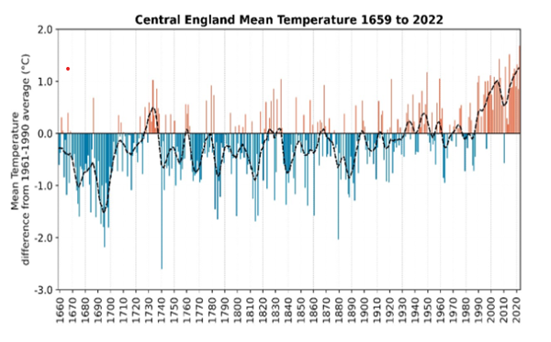
And They Show A Slowly Increasing Linear Trend In Temperature Since Records Began In 1659 In England.
England Is The Very Country Where The Industrial Revolution Began So The Records Are Very Relevant.
Figures are the variation to the 1961-1990 average ºC
The temperature was increasing linearly well before man could have caused it.
Industrial Revolution began
https://www.metoffice.gov.uk/research/climate/maps-and-data/cet-series

Slide 10
And This Presentation Will Explain Why The Temperature Is Increasing, & The Fantastic News From Using Fossil Fuel
Industrial Revolution began
https://www.metoffice.gov.uk/research/climate/maps-and-data/cet-series

Slide 11
As In The UK, Figures From Dunedin (NZ) Since 1909 (NIWA Data) Also Show A Linear Increase In Temperature.
113 Yrs Of Data.
Note that it is the minimum’s that are warming the most

Slide 12
And The Same For Lincoln (NZ) Since 1909 (NIWA)

Slide 13
Trends In NZ Data Agree With That Of The World’s Oldest Temperature Records
https://www.metoffice.gov.uk/research/climate/maps-and-data/cet-series

Slide 14
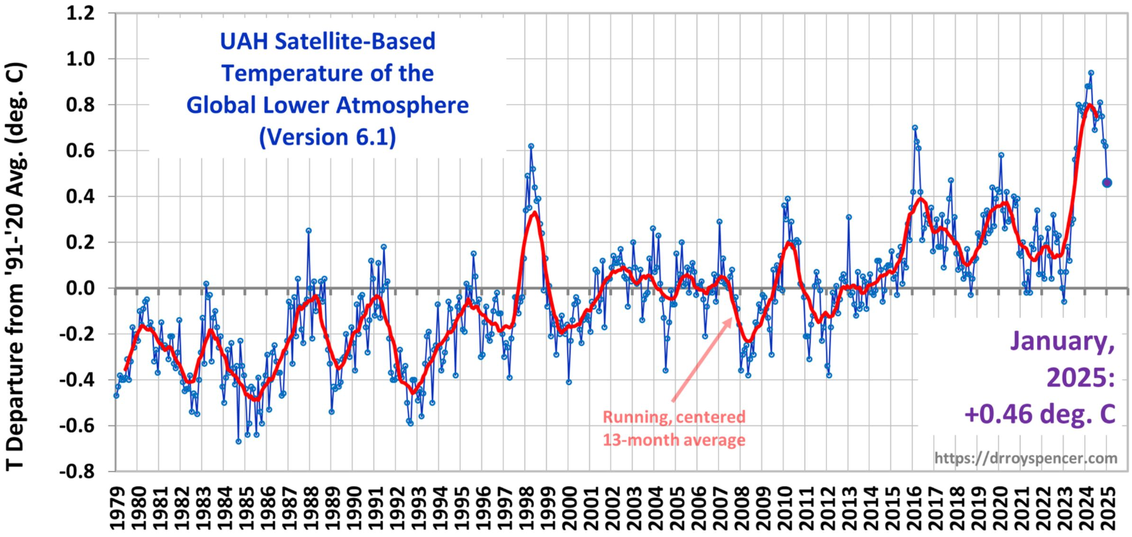
This Is The Satellite Data
Like the oldest temperature records, the satellite data shows a linear increase
Satellite Monitoring Of The Earth’s Lower Atmospheric Temperature Began In 1979 & The Two Scientists Who Invented The Technology Won The Prestigious Science Award While At NASA.
El Nino
Mt Pinatubo eruption
https://www.drroyspencer.com/wp-content/uploads/UAH_LT_1979_thru_January_2025_v6.1_20x9-scaled.jpg

Slide 15
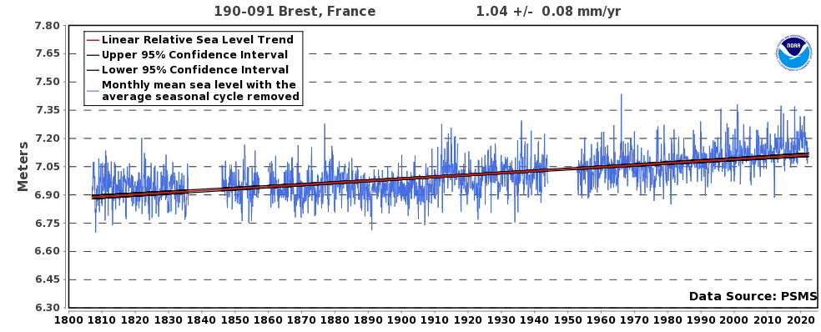
The Oldest Sea Level Records
A linear increase in the rate in sea level rise since 1807 in Brest, France
https://tidesandcurrents.noaa.gov/sltrends/sltrends_station.shtml?id=8518750

Slide 16
The Sea Level Rise Is Well Correlated With The Slow Rise In Temperature Since Before Man Could Have Caused It
https://www.metoffice.gov.uk/research/climate/maps-and-data/cet-series

Slide 17
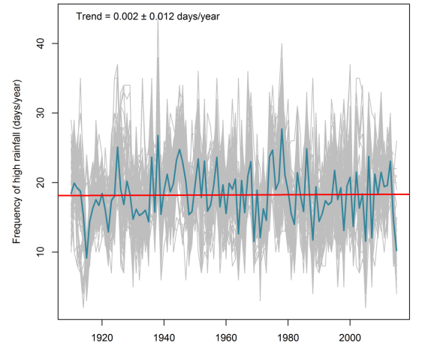
Droughts, Floods or Extremes In Rainfall Are Not Increasing In NZ
Time series of annual frequency of high rainfall for 126 rainfall sites within 10 km of the Selwyn District (NZ) over 110 yrs. The red line is the mean.
IMPACT OF CLIMATE CYCLES AND TRENDS ON SELWYN DISTRICT WATER ASSETS Helen Rutter (Aqualinc Research Ltd); Murray England (Selwyn District Council); Tim Kerr (Aqualinc Research Ltd)

Slide 18
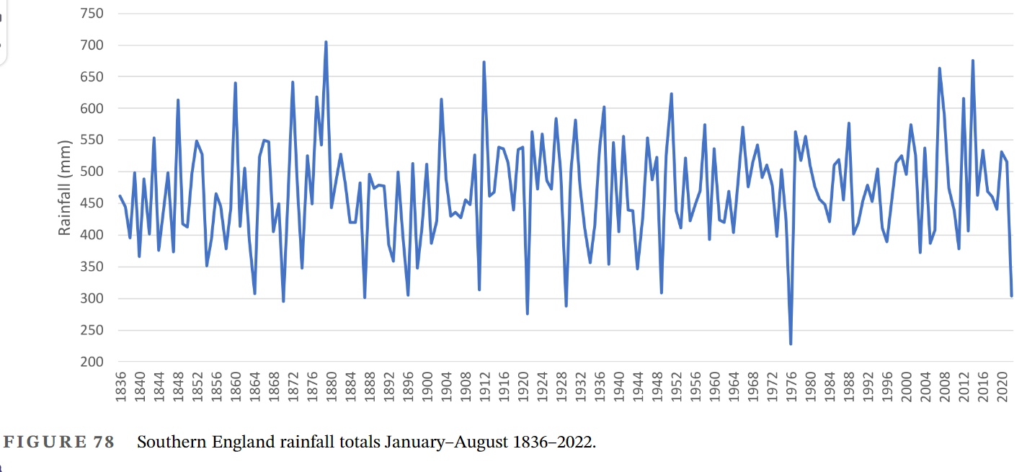
Droughts, Floods or Extremes In Rainfall Are Not Increasing In The UK
186 years of rainfall totals from Jan-Aug in Southern England
https://rmets.onlinelibrary.wiley.com/doi/epdf/10.1002/joc.8167

Slide 19
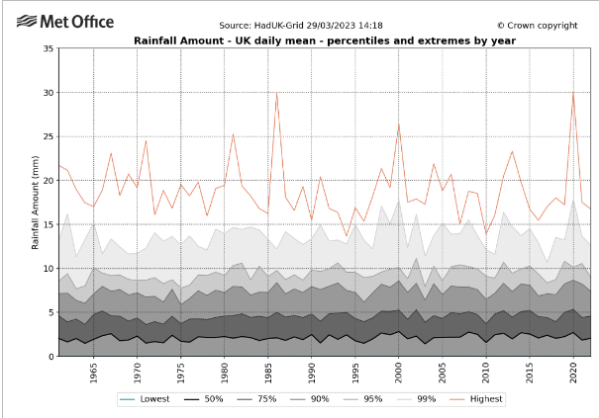
62 years of data showing the trend in rainfall extremes in the UK.
There is no worsening trend either way to flooding or droughts?
https://rmets.onlinelibrary.wiley.com/doi/epdf/10.1002/joc.8167

Slide 20
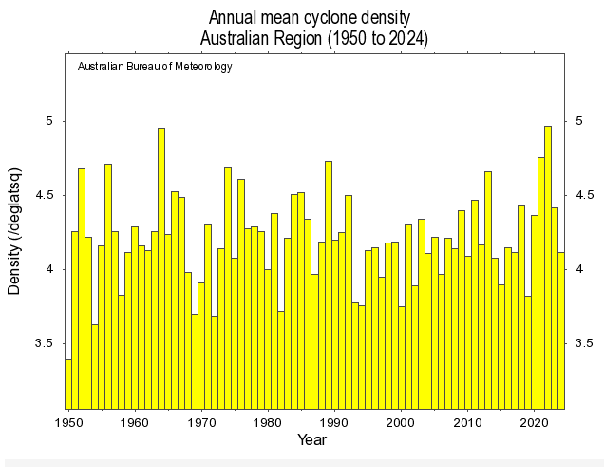
Or Causing More Cyclones
Australian annual cyclone density 1950-2024 (74 years)
http://www.bom.gov.au/cgi-bin/climate/change/timeseries.cgi?graph=low_density&area=aus&season=0112

Slide 21
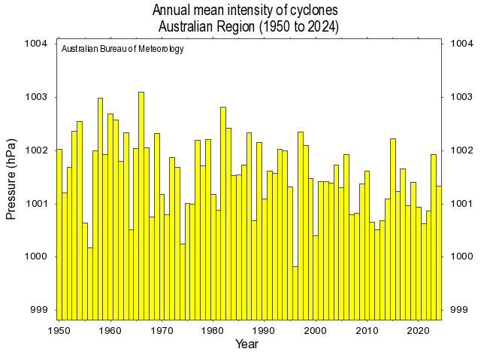
Or Their Intensity
Australian annual cyclone intensity
1950-2024 (74 years)
http://www.bom.gov.au/cgi-bin/climate/change/timeseries.cgi?graph=low_centint&area=aus&season=0112&ave_yr=0

Slide 22
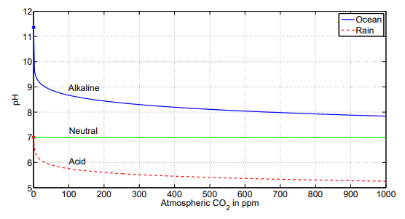
And All This Is Happening Without Causing Acidity Of Our Oceans
Today
168 yrs to double CO₂ at present rate of increase of 2.5 ppm/yr
Impact On Ocean pH As Atmospheric CO₂ Increases, At A Fixed Ocean Temperature Of 25ºC
co2coalition.org/wp-content/uploads/2021/11/2015-Cohen-Happer-Fundamentals-of-Ocean-pH.pdf

Slide 23
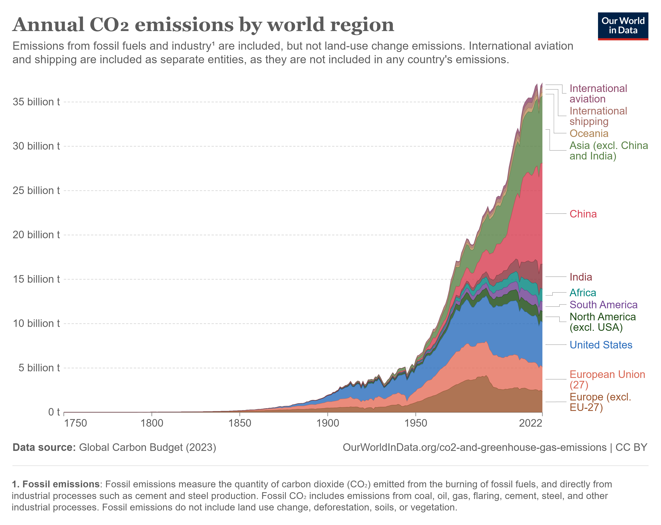
As We Have Seen, There Are No Signals Of Manmade Climate Change Despite
A 371,500% increase in CO₂ emissions should be showing obvious evidence in climate parameters
37.15 billion tonnes in 2022
10.0 million tonnes in 1750 at the start of the Industrial Revolution
371,500% increase in CO₂ emissions

Slide 24
But there is no such evidence, and since the official claim is that man is causing global warming, we must reject the official claim.
Industrial revolution started 1750
371,500% increase

Slide 25
Obviously We Didn’t Cause The Gradual Rise In Temperature, & Even The IPCC Says That At Most, We Have Caused A 1% Warming Effect https://www.youtube.com/watch?v=l90FpjPGLBE

Slide 26
If We Didn’t Cause The Slow Increase In Temperature From Before The Industrial Revolution, Then What Did?
Session 2 will answer that question.

Slide 27
Summary Of Session 1
Session 2
The oldest temperature records in the world, predate by nearly 100 yrs, the Industrial Revolution, the period when man started using large masses of fossil fuels.
371,500% exponential increase in CO₂ emissions
Conclusion
Man’s emissions have had zero or a negligible effect on the linear rate of increase of the earth’s temperature.
Industrial Revolution Began in 1750
The official narrative is therefore wrong
https://www.metoffice.gov.uk/research/climate/maps-and-data/cet-series

Slide 28
If We Couldn’t Have Caused The Slow Linear Increase In Temperature From Before The Industrial Revolution, Then What Did?
The late 1600’s have the coldest records in the last 365 years
Industrial Revolution Began in 1750
https://www.metoffice.gov.uk/research/climate/maps-and-data/cet-series

Slide 29
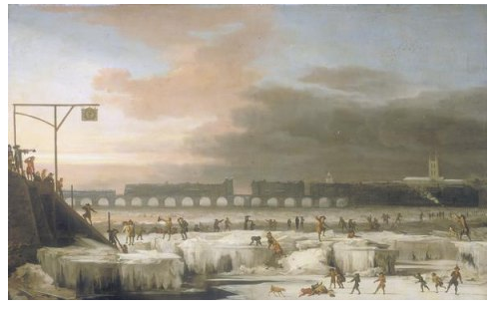
Eyewitness Accounts, Not Theory, Give Us The Answer.
UK Records Show That The Thames Froze Regularly Between 1607-1815.
This Painting from 1677, shows the frozen Thames
During the Great Winter of 1683 / 84, where even the seas of southern Britain were frozen solid for up to two miles from shore, the most famous Frost Fair was held.
https://www.historic-uk.com/HistoryUK/HistoryofEngland/The-Thames-Frost-Fairs/

Slide 30
How Do The Eyewitness Accounts Of The Frozen Thames Between 1607-1815 Compare With The Temperature Records?
The temperature records are validated by the eyewitness accounts so we can make firm conclusions from the evidence.
https://www.metoffice.gov.uk/research/climate/maps-and-data/cet-series

Slide 31
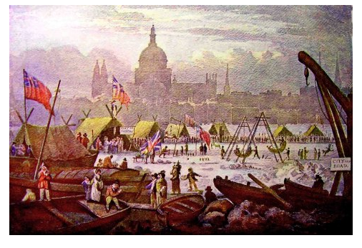
1814
By the 1800’s the climate had started to warm, the severity of the winters had waned and the last ever London Frost Fair took place in the January of 1814.
https://www.historic-uk.com/HistoryUK/HistoryofEngland/The-Thames-Frost-Fairs/

Slide 32
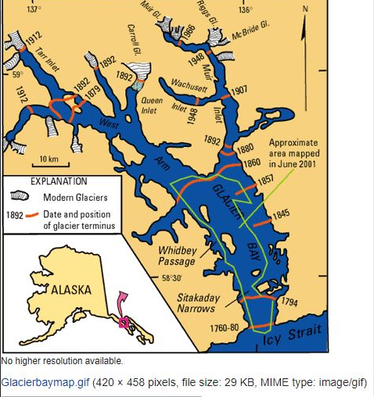
The extent of ice at Glacier Bay (Alaska) has been well recorded and the melt began before the Industrial Revolution in 1750

Slide 33
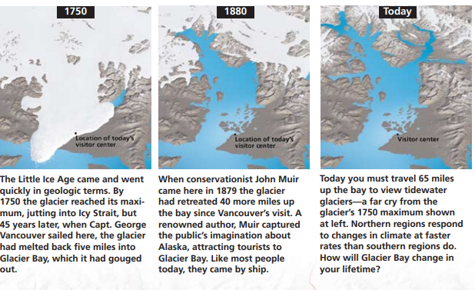
Note, At Glacier Bay (Alaska) Most Of The Ice Had Melted By 1880

Slide 34
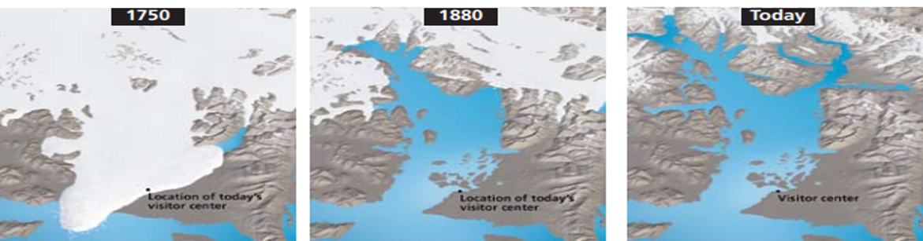
Most Of The Ice That Has Gone Today Had Done So By 1880
https://www.metoffice.gov.uk/research/climate/maps-and-data/cet-series

Slide 35
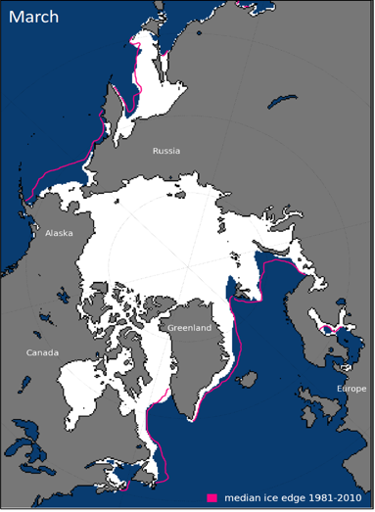
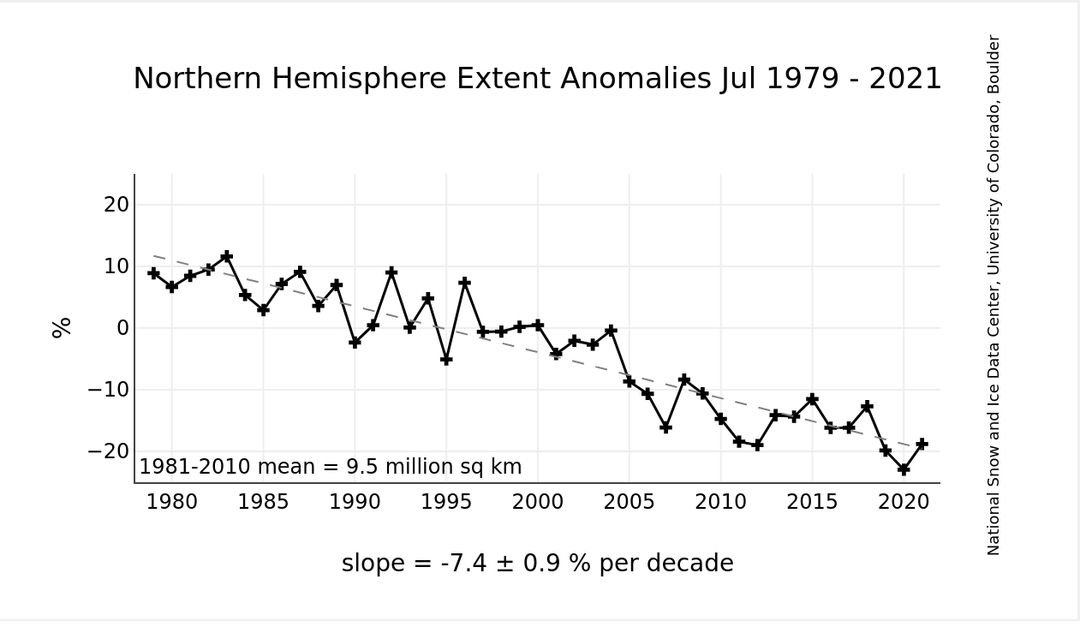
So With Ice Melting Nearby At Glacier Bay In Alaska Since At Least 1750, It Is No Surprise That The Arctic Sees Reducing Sea Ice Today?
North Pole
Glacier Bay, Alaska

Slide 36
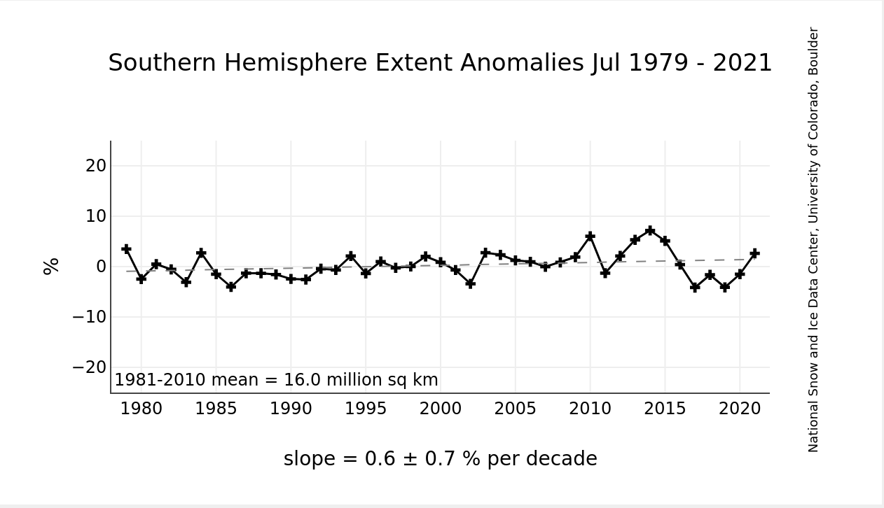
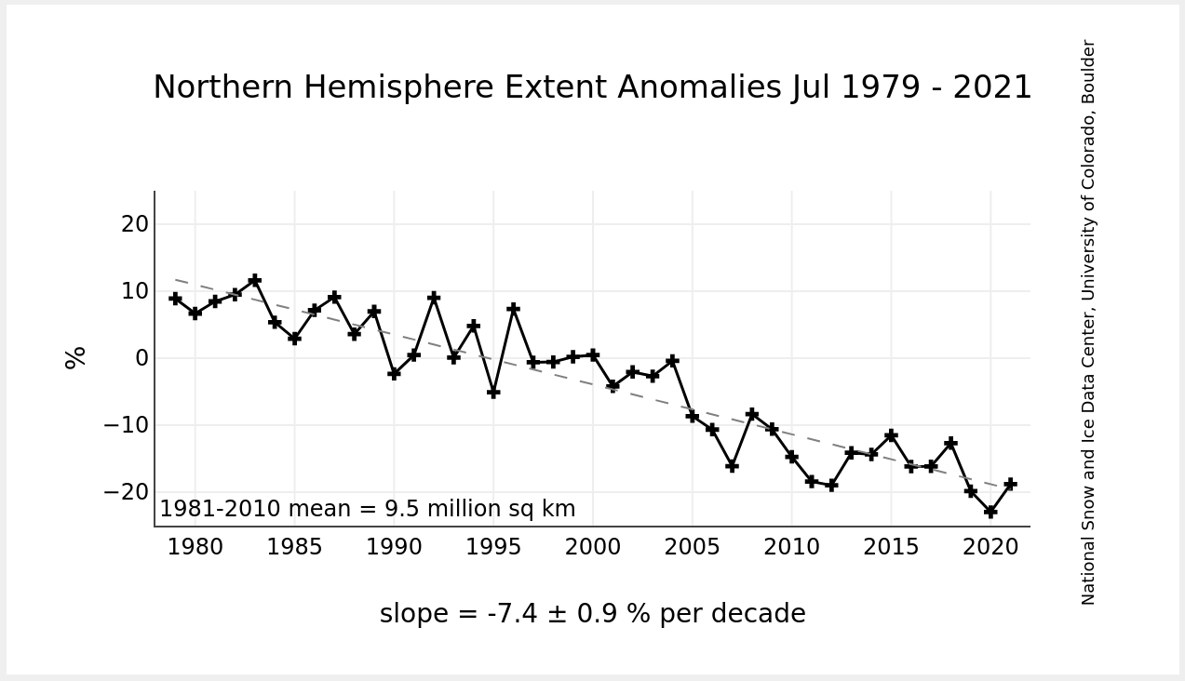
Of interest, while the Arctic has declining ice, Antarctica with 90% of the earth’s ice, has shown a slight INCREASE in ice since satellite photos began in 1979
https://nsidc.org/data/seaice_index/

Slide 37
So We Know The Glaciers Were Melting From At Least mid-1700
And since then the world’s ice has been melting, except in Antarctica, the coldest part of the planet with 90% of the world’s ice
This in part explains why sea level has been slowly increasing as shown in France since 1807. Thermal expansion of the oceans from the linear temperature increase is also contributing to sea level rise.

Slide 38
Clearly Something Happened To The World To Create 200 Years of Severe Cold
It is called The Little Ice Age.
And since then the earth has been slowly warming
https://www.metoffice.gov.uk/research/climate/maps-and-data/cet-series

Slide 39
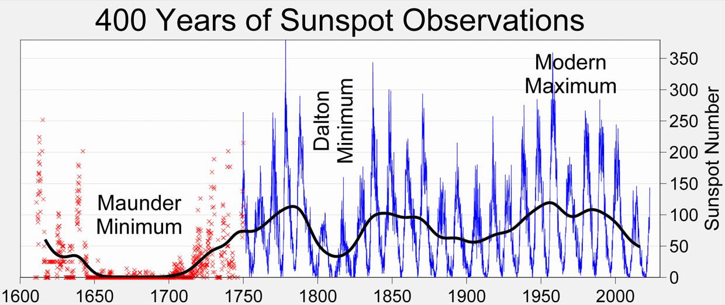
So What Could Have Caused The Little Ice Age?
https://upload.wikimedia.org/wikipedia/commons/2/28/Sunspot_Numbers.png

Slide 40
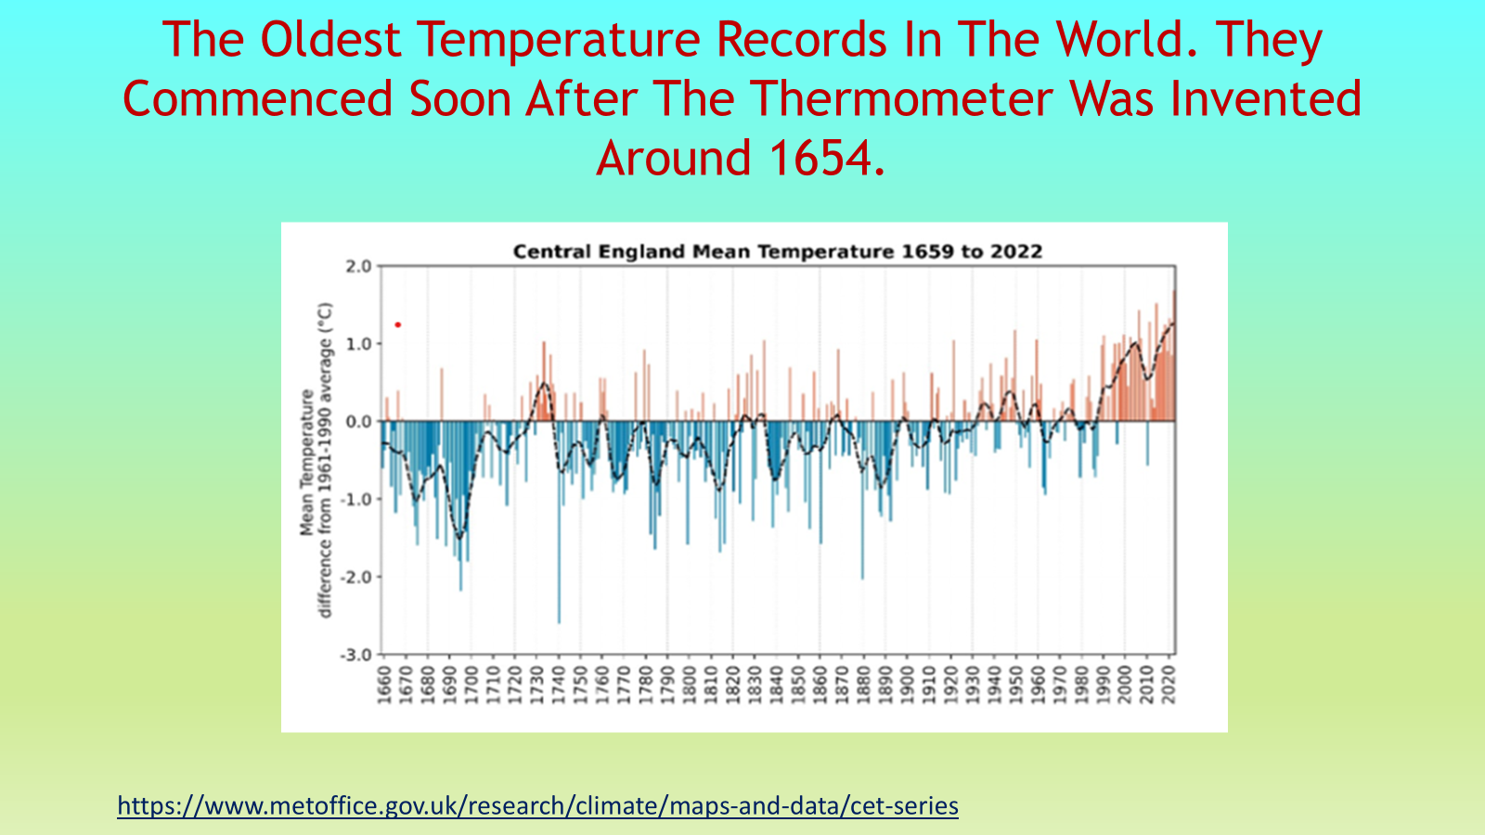

Slide 41
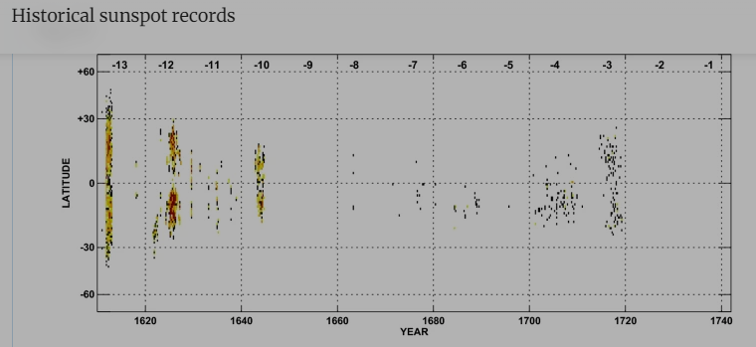
Sunspot Records Support A Likely Explanation For The Little Ice Age – Records From 1610-1740

Slide 42
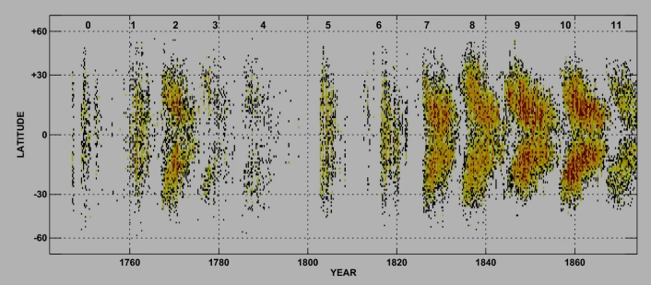
Sunspot Records 1740-1875

Slide 43
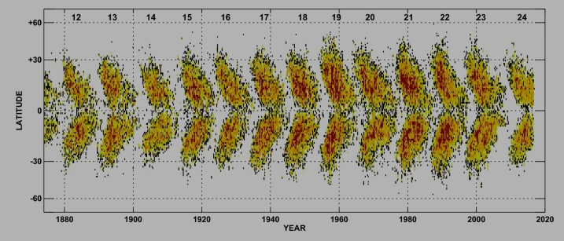
Sunspot Records – 1875-2020

Slide 44
Volcanic Activity Is Also Linked To The Little Ice Age
Journal of Volcanology and Geothermal Research 11: (1) 1981: page 3-10 states “Comparison with various climatic records suggest that periods of frequent and violent eruptions usually coincide with cold climatic conditions. For example, the highest volcanic activities since A.D. 553 occurred in A.D. 1250-1500 and A.D. 1550-1700, i.e. in the initial and culminating phases of “the Little Ice Age”.

Slide 45
Volcanic Activity Is Also Linked To The Little Ice Age (cont)
Dr Gifford Miller led a team of scientists from the University of Colorado at Boulder, USA, and he is quoted by BBC Environmental corresponded, Richard Black, on 30 Jan 2012 as saying “A series of eruptions just before 1300 lowered Arctic temperatures enough for ice sheets to expand and this would have kept the Earth cool for centuries”. He believes the Little Ice Age had volcanic origins.

Slide 46
Volcanic Activity Is Also Linked To The Little Ice Age (cont)
A 2012 study by Miller and colleagues using radiocarbon-dated mosses that emerged from under the Baffin Island ice caps and sediment cores from Iceland suggested that the trigger for the Little Ice Age was likely a combination of exploding tropical volcanoes – which ejected tiny aerosols that reflected sunlight back into space – and a decrease in solar radiation.
https://www.colorado.edu/today/2013/10/23/cu-boulder-led-study-shows-unprecedented-warmth-arctic

Slide 47
Summary Of The Evidence
The Little Ice created a cold period between 1600-1800 caused by significant volcanic activity & reduction in sun spots.
Recovery back to temperature homeostasis is the cause of the slow rise in annual temperature.
Any attempts by man to reduce emissions will only cause economic hardship, especially for the poor & middle classed, and have zero impact on temperature rise & climate.
Anybody harping on about the world reaching new record highs is not aware of the slow linear increase in temperature since before the Industrial Revolution, which means that we will regularly set new records that will happen irrespective of man.

Slide 48
Summary Of The Science (cont)
NZ Climate Change Commission says “In the face of the sharpening climate change challenge, the world is intensifying efforts to reduce greenhouse gas emissions (GHG) in ways that will sustain and keep their communities safe. Aotearoa New Zealand has committed to this global response and is building its own transition to a thriving, low emissions economy.” page 32
https://www.climatecommission.govt.nz/public/Uploads/EB4/supporting-docs/20240403-EB4-draft-advice-P05-V01-compressed.pdf
If man has not caused a noticeable increase in temperature & is not causing acidification of the oceans or droughts, floods or intensity of rain, or increased sea level rise, then how can man justify spending anything on reducing emissions and expect to see a humanitarian, financial or environmental return?
In Session 3 we will see that using fossil fuel is actually very good for feeding the earth’s population.

Slide 49
Here Is Fantastic News, But First, Some Background Information

Slide 50
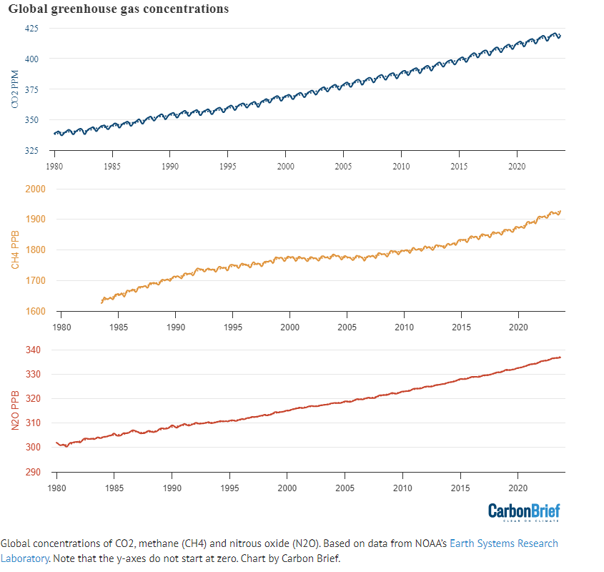
These Three Gases Are Being Demonised By Many Western Govt’s Around The World, Including NZ.
Atmospheric CO₂ levels in ppm (parts per million). Note 420 ppm is the same as 0.042% or 0.042 parts per hundred. It is currently increasing at 2.45 ppm/yr
Atmospheric CH₄ (methane) levels in ppb (parts per billion). 1900 ppb is the same as 0.00019% or 0.00019 parts per hundred. Will soon show this is having a miniscule affect on the warming.
Atmospheric N₂O (Nitrous Oxide) Levels in ppb (parts per billion). 330 ppb is the same as 0.0000330% or 0.0000330 parts per hundred. Will soon show this is having a miniscule affect on the warming.
https://www.carbonbrief.org/state-of-the-climate-2023-smashes-records-for-surface-temperature-and-ocean-heat/

Slide 51
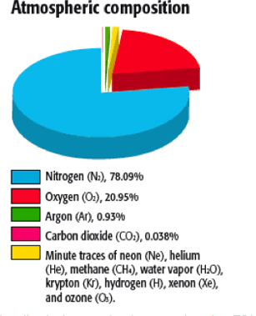
The pink portion is CO₂
It currently forms 0.0420% of our atmosphere on a volume basis.
That is the same as 420 ppm
When first measured in Mauna Loa in Hawaii in 1958 it was 313 ppm.
Despite being such a small volume it helps to keep us warm.
Without it & the other greenhouse gases (GHG’s) the earth would average -9oC instead of 15.5oC
Water vapour is the biggest GHG
CO₂

Slide 52
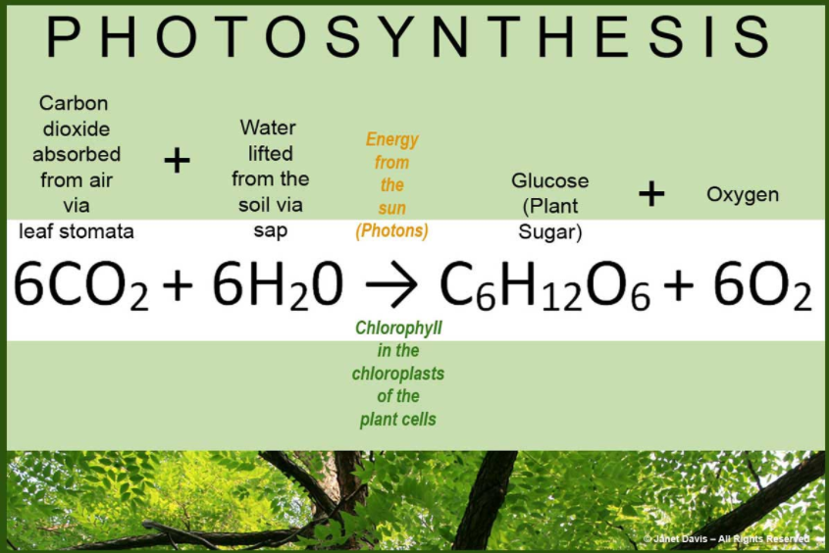
Not Only Does CO₂ Help To Keep Us Warm But Without It We Would Starve & Suffocate
It is therefore our essential friend.
Via Photosynthesis Plants Convert:
264 gms of CO₂ into 180 gms of Glucose & 192 gms of Oxygen.
2.87 MJ Of Energy From The Sun Drives The Equation
This is the start of our food supply chain & our source of oxygen.
Notes:
When we said grace, this biochemical equation sits as one of the main reasons we do so. We wouldn’t be here without it.

Slide 53
And At 50 ppm CO₂ We Couldn’t Survive Because Plants Would Die & We Wouldn’t Have Oxygen
So we know that the earth has never been at 50 ppm CO₂

Slide 54
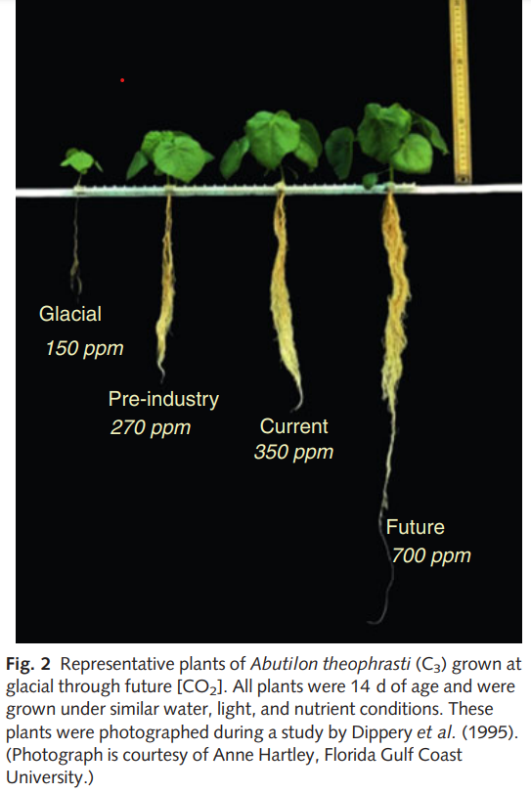
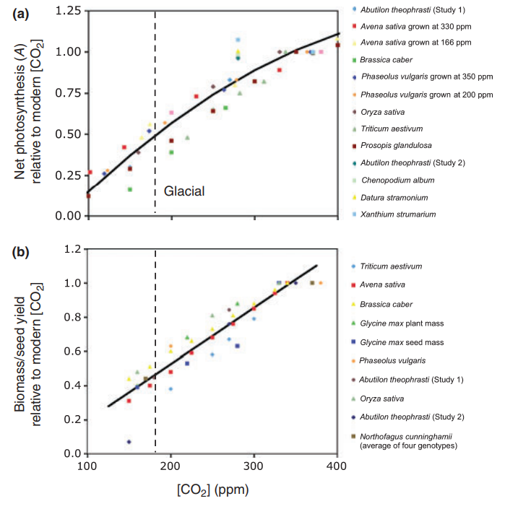
New Phytologist (2010) 188: 674–695 (University of Kansas Research)
Oats
Beans
Wheat
Plants stop photosynthesising by 50 ppm, so die

Slide 55
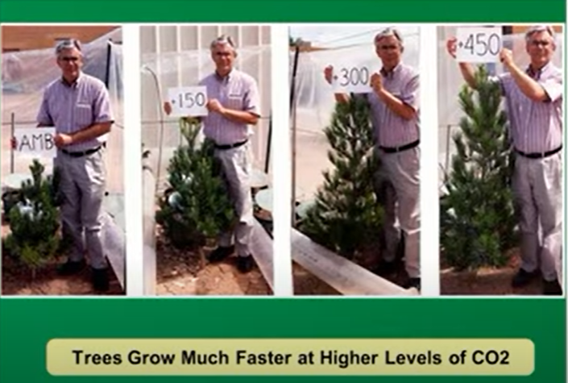
CO₂ Is Plant Food. Increasing It Increases Plant Production. This Is Research From Arizona State University
Ambient = 380 ppm
+450 = 830 ppm
Explains why tomato farmers pump up to 1,200 ppm CO₂ into their greenhouses to increase yield.

Slide 56
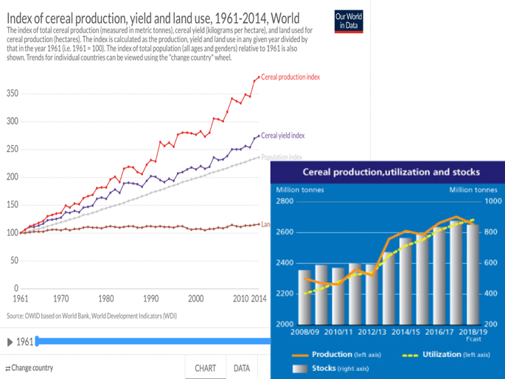
Not Surprising That Increasing CO₂ Is Helping To Increase World Food Production
World cereal production (tonnes)
% increase
Yield per Hectare (kgs)
Population
Land In Cereal Production

Slide 57
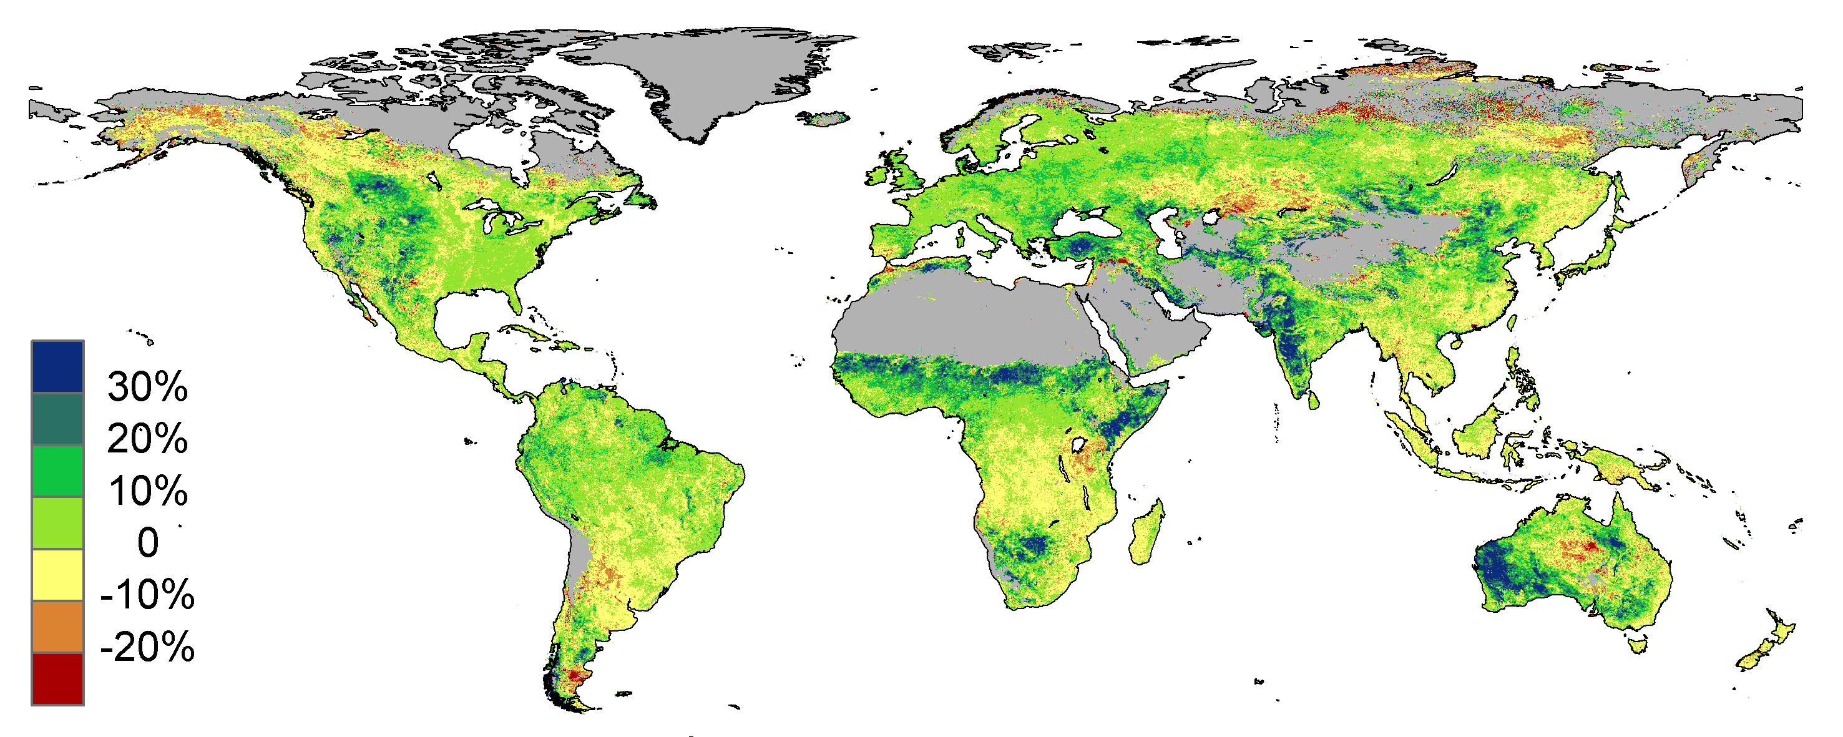
Increased levels of CO₂ have helped boost green foliage across the world’s arid regions over the past 30 years through a process called CO₂ fertilisation, according to CSIRO research.
https://www.youtube.com/watch?v=S-nsU_DaIZE&ab_channel=ReasonTV

Slide 58
From Ice Core Samples The Level Of Atmospheric CO₂ At The Start Of The Industrial Revolution In 1750 Was About 280 ppm.
Therefore by burning fossil fuels we are helping plants to feed the planet.

Slide 59
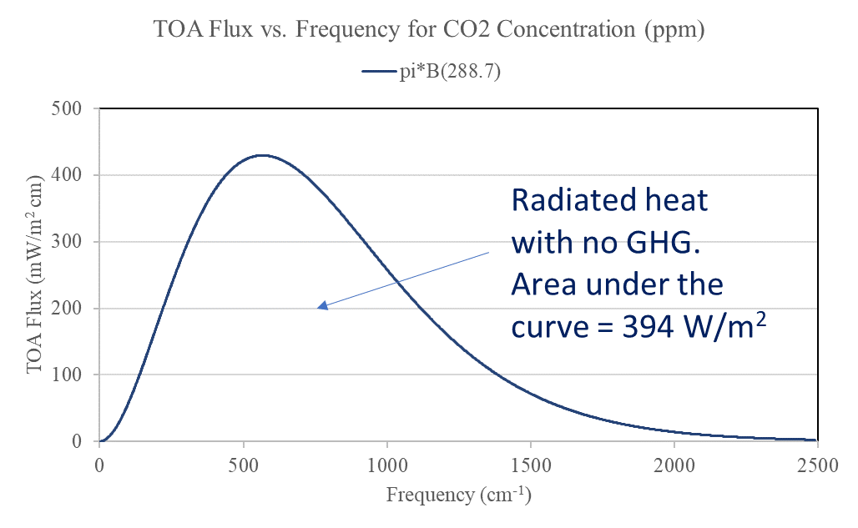
So If CO₂ Was 280 ppm At The Start Of The Industrial Revolution, Can The Warming Affect Be Calculated If CO₂ Is Doubled From The Present 420 ppm To 840 ppm, If We Keep Burning Fossil Fuels? The Answer Is Yes.
This will take 171 years if the present rate of increase continues at 2.45 ppm/yr.
Graph relates to a cloud free atmosphere

Slide 60
If All The Green House Gases (GHG) Are Added Except CO₂

Slide 61
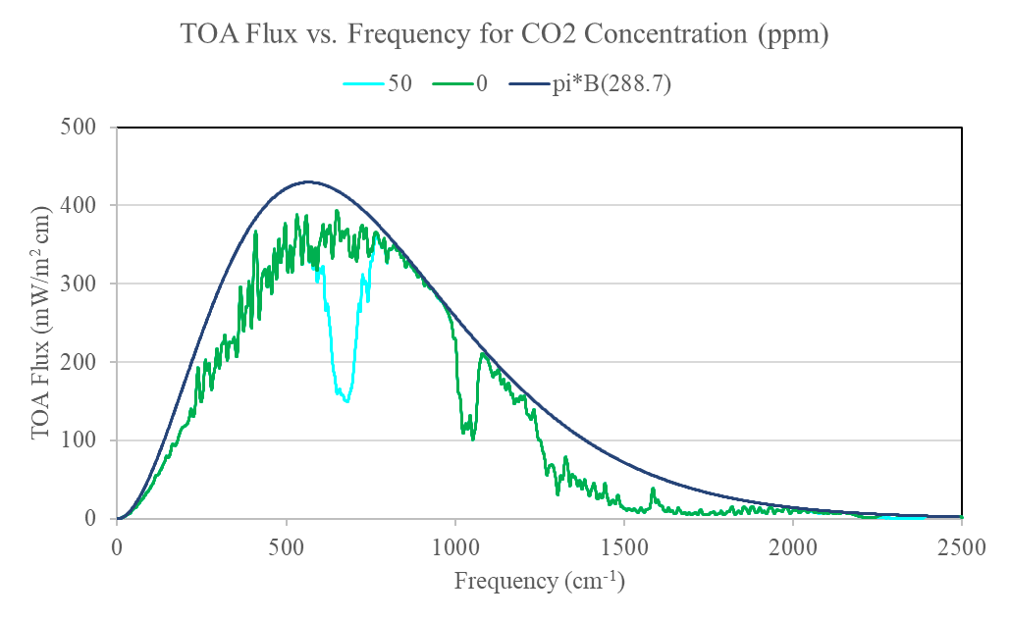
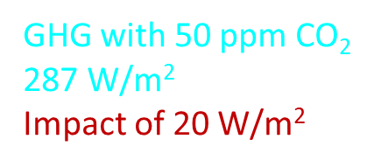
If All The Green House Gases (GHG) But Only 50 ppm Of CO₂

Slide 62
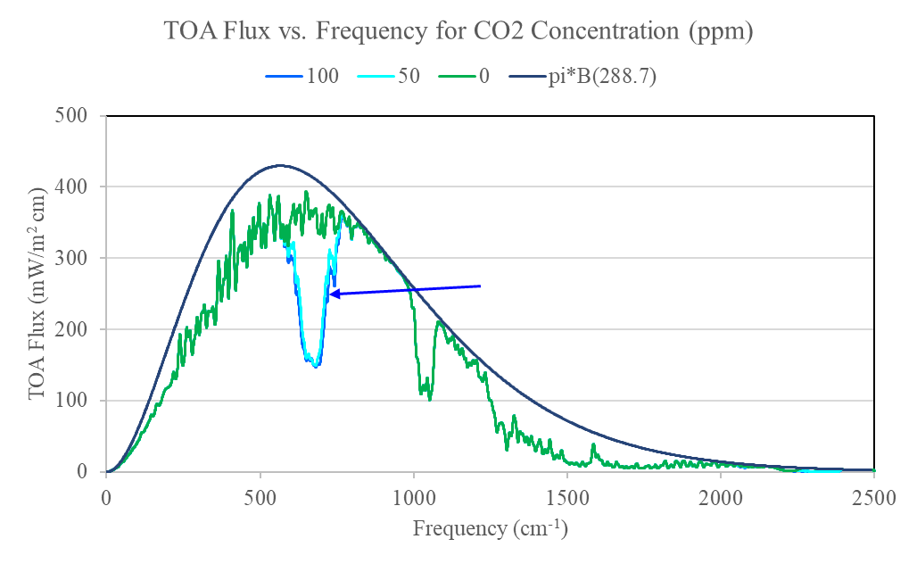
If All The Green House Gases (GHG) But Only 100 ppm Of CO₂
GHG with 100 ppm CO₂ 284 W/m²
Impact of 3 W/m²

Slide 63
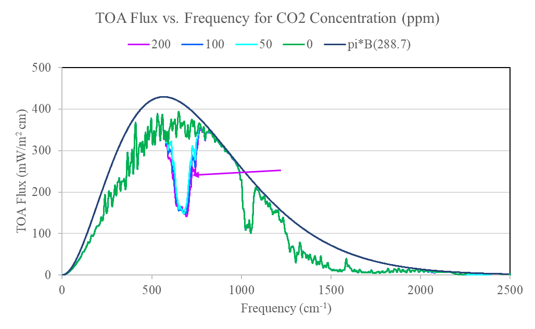
If All The Green House Gases (GHG) But Only 200 ppm Of CO₂
GHG with 200 ppm CO₂ 281 W/m²
Impact of 3 W/m²

Slide 64
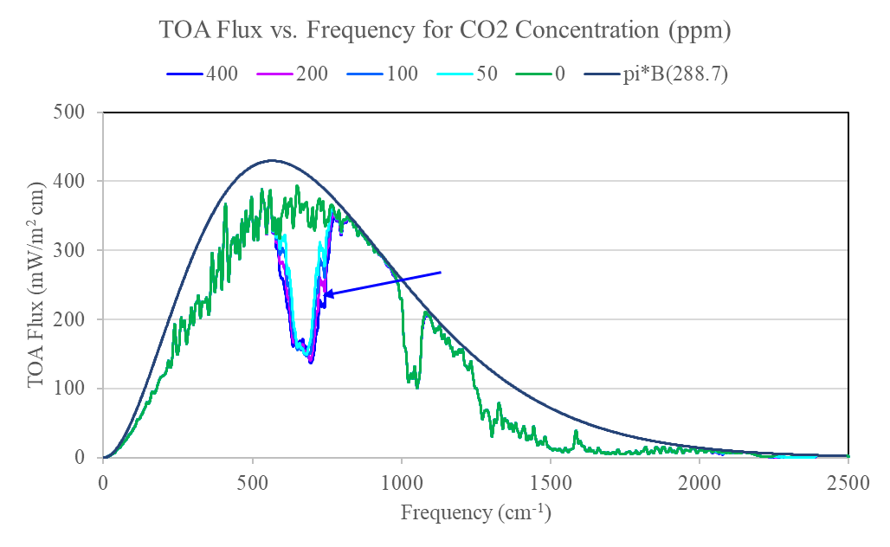
If All The Green House Gases (GHG) But Only 400 ppm Of CO₂
Where It Is At Present
GHG with 400 ppm CO₂ 278 W/m²
Impact of 3 W/m²

Slide 65
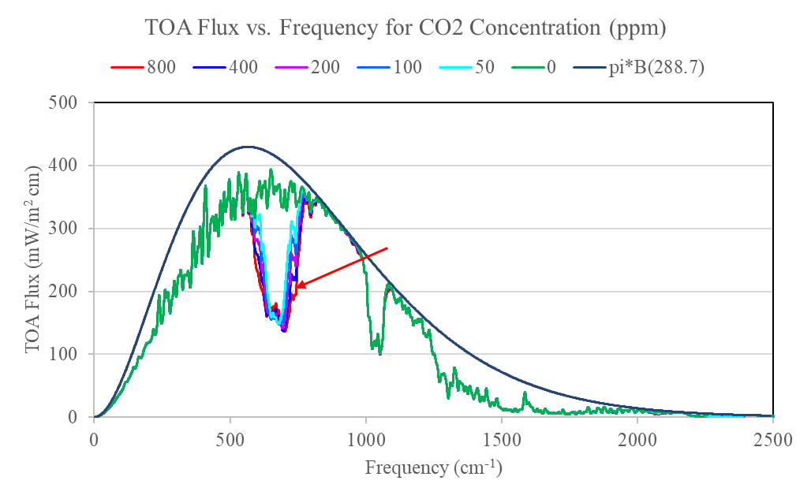
If All The Green House Gases (GHG) But 800 ppm Of CO₂
Double The Present
GHG with 800 ppm CO₂ 275 W/m²
Impact of 3 W/m²

Slide 66
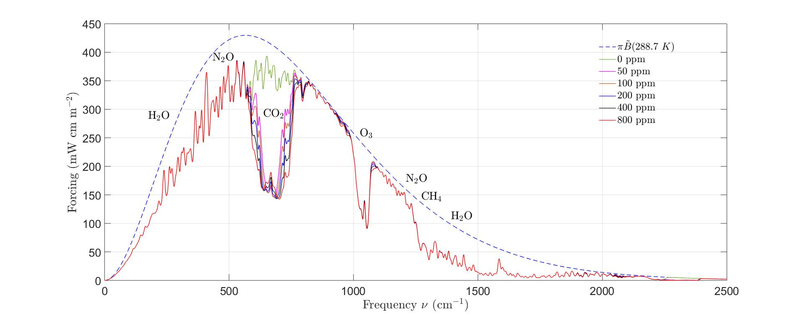
Summary
ppm | W/m² | Change
No GHG | 394
GHG with 0 ppm CO₂ | 307 | 87
50 | 287 | 20
100 | 284 | 3
200 | 281 | 3
400 | 278 | 3
800 | 275 | 3
Radiated heat with no GHG 394 W/m²
GHG but no CO₂ 307 W/m²
We are currently at 420 ppm
And the annual rate of increase is about 2.45 ppm
It will take 171 yrs to add 3 W/m² or 1% In Radiant Heat Effect
Calculations & data supplied by Prof W. van Wijngaarden & Prof W. Happer

Slide 67
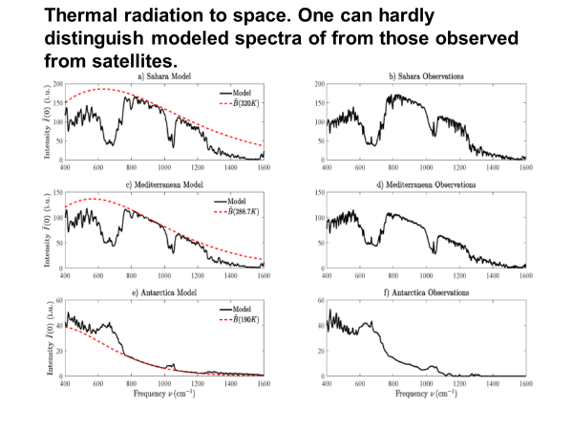
How Good Are Prof van Wijngaarden & Prof Happer At Calculating The Greenhouse Effect?
Their predictions match reality.
Their scientific method passes the truth test.
Modelled
Measured (With Satellites)
Over the Sahara @ 47oC
Over the Mediterranean @ 15oC
Over Antarctica @ -83oC

Slide 68
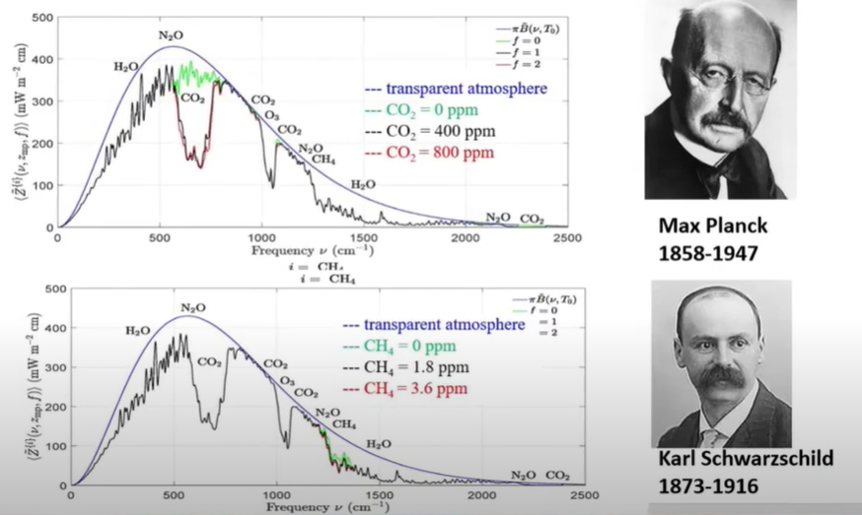
So What About Methane (CH₄) From Our Cows, The Other Gas Being Demonised?
Methane (CH₄) was first measured at 1.6 ppm in 1983 & is now 1.9 ppm.
See if you can see the influence of doubling it from 1.8 ppm to 3.6 ppm (black line to red line)
At the current rate of increase it will take 240 yrs to reach 3.6 ppm.
Why are we penalising ruminant milk & meat production?
Without them we can’t meet the protein needs of the world.
CO₂
Methane (CH₄)
Notes:
Max Plank is a famous physicist who measured how heat radiates from a black object, like the earth.
Karl Schwartzschild showed what then happens to thermal radiation once greenhouse gases are added to the atmoshphere.
The top graph highlights CO2 and the bottom one, CH4
Note the tiny effect from doubling CO2 or CH4

Slide 69
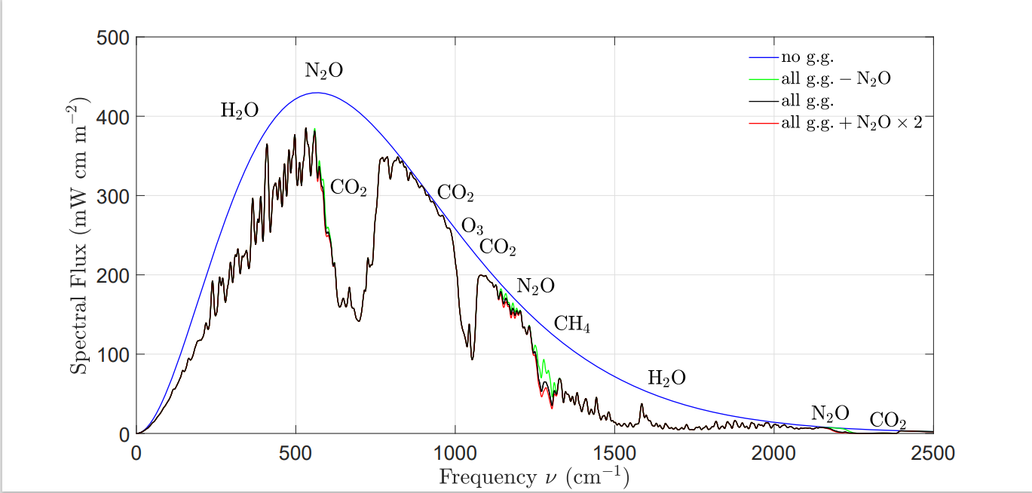
And N₂O, nitrous oxide, the new demon being canvassed as a reason to restrict agriculture
So why is N₂O being demonised?
N₂O was first measured in the atmosphere in 1978
It is currently 333 parts per billion (ppb) & increasing at 1 ppb per yr
With current N₂O levels the greenhouse effect is the black line
Greenhouse effect with all greenhouse gases, except N₂O (green line)
If N₂O was doubled (333 ppb to 666 ppb which would take 333 years) the greenhouse effect would be the red line

Slide 70
It Is Easy To See That Increasing CO₂ Hasn’t & Will Not Cause An Increase In Measurable Warming.
And even better news, burning fossil fuels is helping to feed the world by increasing agricultural output & that ruminant farming is having a negligible effect on temperature rise

Slide 71
So What About The Models Claiming That Man Is Causing Climate Change?

Slide 72
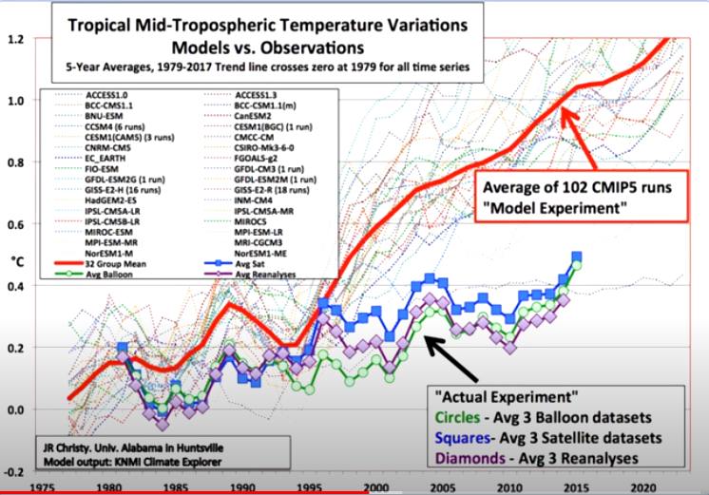
Governments & Councils Are Using Climate Models With 200%-400% Error When Predicting Historic Temperature To Make Predictions For Their Long Term Plans?
The models have an error of >200% compared to actual records from weather balloons & satellites.
The scientist referenced below won a prestigious science award when he was at NASA, for putting a satellite into space to measure the earth’s temperature.
https://www.youtube.com/watch?v=I8hdE3eZ6vs&feature=youtu.be

Slide 73
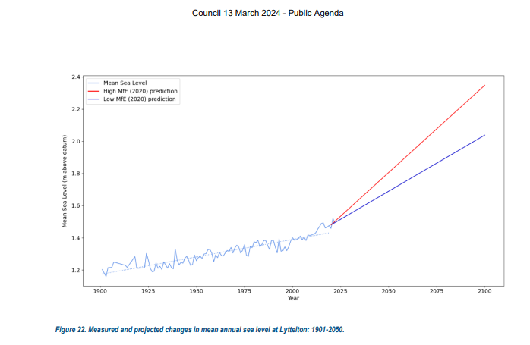
This Is What The Models Are Predicting For Lyttelton’s Sea Level According To The Ministry For The Environment (MfE).
High Prediction
Low Prediction
https://www.selwyn.govt.nz/__data/assets/pdf_file/0003/2141364/13-March-2024-Part1.pdf

Slide 74
Some Explanation Of Terminology Is Needed Before We Progress
The Intergovernmental Panel on Climate Change (IPCC)
releases Assessment Reports (AR’s), the latest was released in 2021 & is called AR6, the previous one in 2013 is called AR5
Coupled Model Intercomparison Projects (CMIP’s) are a compilation of the results from climate modelling groups from around the world. Their information is included in AR reports e.g. CMIP6 data is in the AR6 report.
RCP’s (Representative Concentration Pathways) in AR5 have been changed to SSP’s (Shared Socioeconomic Pathways) in AR6.
RCP8.5 refers to a radiative forcing of 8.5W/m²
RCP2.6, RCP4.5, RCP6.0 & RCP8.5 have become SSP1-2.6, SSP2-4.5, SSP4-6.0 & SSP5-8.5
https://www.carbonbrief.org/cmip6-the-next-generation-of-climate-models-explained/

Slide 75
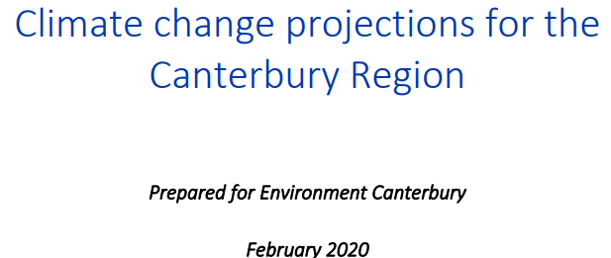

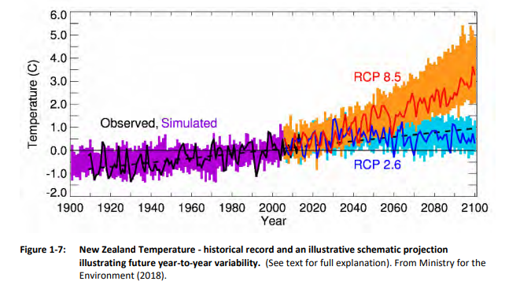
What RCP (SSP) Figures Is NZ Officially Using?
The report says
“The NIWA report looks at two scenarios: RCP4.5 (which could be realistic if immediate global action is taken towards mitigating climate change) and RCP8.5 (sometimes called the 'business-as-usual', where emissions continue at current rates)”.
See for yourself from NIWA’s own data, does RCP 8.5 look like “business as usual”?
Obviously not, but RCP2.6 should be labelled “business as usual”.

Slide 76

Which RCP (SSP) Figure Should Be Used In NZ?
The temp increase from 1880-1900 to 2090-2100 with RCP2.6 & SSP1-2.6 is predicted to average 1.7oC – 2.0oC resp’y.
RCP2.6
That is an average of about 0.93oC per century
According to NIWA records, NZ has averaged 1.0oC per century since 1909 (see next slide) so RCP2.6 seems appropriate
“CMIP5 and CMIP6 warming between 1880-1900 and 2090-2100 for RCP scenarios and their new analogues. The range reflects the lowest and highest warming among models for each scenario, while the labelled dots show the multi-model mean. Chart by Carbon Brief using Highcharts”.
https://www.carbonbrief.org/cmip6-the-next-generation-of-climate-models-explained/

Slide 77
The Temperature Trends Of 7 Sites Reported By NIWA Since 1909. Note The Linear Increase & Mainly Minimums.

Slide 78
Is This Consistent With What Is Happening Around The World
RCP8.5 is obviously not “business as usual”.
RCP4.5 is also not appropriate
High-End Scenario
(rcp8.5) which will not happen
Data Provided By Prof John Christy (pers comm)
Distinguished Professor, Atmospheric and Earth Sciences
Director, Earth System Science Center
Alabama State Climatologist
The University of Alabama in Huntsville
°C
Modest Growth Scenario
rcp4.5
Observations
He won a prestigious science award while at NASA for putting the satellite into space to measure the earth’s temperature.
We are 1/3 of the way from 1980 to 2100 and the models are already significantly in error – something needs to be fixed

Slide 79
Comparing Observations Against NZ Predictions
High-End Scenario
(rcp8.5) which will not happen
°C
Modest Growth Scenario
rcp4.5
NZ MfE are obviously using RCP figures in their models that seriously depart from reality
Observations
RCP2.6 fits with “Observations”
We are 1/3 of the way from 1980 to 2100 and the models are already significantly in error – something needs to be fixed

Slide 80

Prof Richard Muller (UC Berkley Professor of Physics) Discusses Cherry Picking The Weather Data
https://www.youtube.com/watch?v=Moum_SZ5NNY

Slide 81

Urban Heat Island Effect From Urban Stations (concrete & bitumen etc) verses Rural Weather Stations
In 2023 in Phoenix, the error from urban stations is 1oC
https://www.drroyspencer.com/wp-content/uploads/Phoenix-for-blog-post.jpg

Slide 82
Other Evidence Of Cherry Picking Or Fabricating The Weather Data
UK Met Office Sources Information From Over 103 Non-Existent Weather Stations
https://realitycheck.radio/replay/chris-morrison-environment-editor-at-the-daily-sceptic-foul-forecasting-uks-met-office-may-be-inventing-data-from-over-100-non-existent-weather-stations/

Slide 83

“NIWA’s Missing Storm Data & Its Impact On Extreme Claims”
This NZ data has been collated by Ian Wishart, investigative journalist (investigatemagazine.co.nz).
It gives a snapshot of storms reported in NZ newspapers from 1868-1890, a short & random period of time.
The storms are ranked based on barometric pressure with Cyclones Bola, Giselle & Gabrielle listed by comparison.
A 1939 storm that caught Ian’s eye while researching, is also listed.
Clearly Cyclone Gabrielle was not a 1 in 250 yr storm as claimed
Ian Wishart concludes from his research that

Slide 84
Other Evidence Of Cherry Picking Or Fabricating The Weather Data
International Consultants, Jacobs, did a report for the Kapiti Council which said that 10,000 homes would be impacted by sea level rise and erosion of the foreshore,
but only 49 homes are at risk according to a report done by Waikato University’s Dr Willem De Lange (Honorary Research Associate)
https://realitycheck.radio/replay/dr-willem-de-lange-honorary-research-associate-waikato-university-on-his-research-coastal-hazard-risk-assessment-for-the-kapiti-coast-and-implications-for-the-areas-future-coastal-planning/
https://realitycheck.radio/replay/salima-padamsey-chair-of-cru-kapitis-coastal-hazard-planning-has-the-moe-been-misreading-the-models/

Slide 85
NZ Emissions Were Only 0.1% Of The World’s Output In 2022 (32.21 Million Tonnes)
China & India are two of several countries who are not restricting emissions
And President Trump has now pulled the US out of the Paris Agreement
https://twitter.com/Restitutor_/status/1778184851885334908
China 11.40 billion tonnes (30.7%) & they are building 2 coal fired power stations/wk.
With China, India, Russia, Indonesia & the US not committing to the Paris Agreement, why are we?
India 2.83 billion tonnes (7.6%) & they are the world’s biggest producers of milk. https://apnews.com/article/methane-emissions-dairy-farming-climate-change-india-global-warming-agriculture-5aa77866e27f6d94e14e4e394e0b7201#:~:text=India%20is%20the%20third%20largest,the%20vast%20majority%20from%20cattle
NZ 32.21 Million Tonnes (0.1%)

Slide 86

Encouragement To Keep Going (cont)

Slide 87
Therefore what is the goal for the previous NZ Gov’t pledging to spend $24 billion ($19,000 per household) on offshore carbon credits by 2030, to return no benefits?
https://breakingviewsnz.blogspot.com/2025/02/barry-brill-creative-accounting-trumps.html

Slide 88
Conclusions
The oldest temperature records prove that man has not increased the rate of global warming, by burning fossil fuels
Increasing the CO₂ stored in the atmosphere or oceans, by burning fossil fuels to make cheap energy, is helping to feed the planet
If we do that without causing air pollution, everybody wins, especially the middle classed & the poor.

Slide 89
It Is Obviously Important That We All Seek The Truth & Ask Our Political Representatives To Do The Same.
The Evidence Clearly Shows That Climate Change Should Not Be A Tool For Fear, Taxes Or Control

Slide 90
There is absolutely no need for young people to think this.
Will you help to dispel this fear with truth?
All it takes is being able to share the key facts that have convinced you tonight that we have good news.
And to do so with gentleness and respect.
https://www.youtube.com/watch?v=Lk9XNoShOPs

Slide 91

There Is No Room For This Type Of Thinking
https://thehighwire.com/ark-videos/aiding-and-abetting/?pg=2

Slide 92
Remember, Using Fossil Fuels To Energise Our Economy Actually Helps To Feed Plants & Feed The Planet At The Same Time.

Slide 93
Thank You.

